Slide 1
DS 4300
Large Scale Information
Storage and Retrieval
Foundations
Mark Fontenot, PhD
Northeastern University

Slide 2
Searching
Searching is the most common operation performed by a database system
In SQL, the SELECT statement is arguably the most versatile / complex.
Baseline for efficiency is Linear Search
Start at the beginning of a list and proceed element by element until:
You find what you’re looking for
You get to the last element and haven’t found it

Slide 3
Searching
Record - A collection of values for attributes of a single entity instance; a row of a table
Collection - a set of records of the same entity type; a table
Trivially, stored in some sequential order like a list
Search Key - A value for an attribute from the entity type
Could be >= 1 attribute

Slide 4
Lists of Records
If each record takes up x bytes of memory, then for n records, we need n*x bytes of memory.
Contiguously Allocated List
All n*x bytes are allocated as a single “chunk” of memory
Linked List
Each record needs x bytes + additional space for 1 or 2 memory addresses
Individual records are linked together in a type of chain using memory addresses

Slide 5
Contiguous vs Linked
6 Records Contiguously Allocated - Array
front
back
Extra storage for a memory address
6 Records Linked by memory addresses - Linked List

Slide 6
Pros and Cons
Arrays are faster for random access, but slow for inserting anywhere but the end
Linked Lists are faster for inserting anywhere in the list, but slower for random access
records:
Insert after 2nd record
records:
5 records had to be moved to make space
Insert after 2nd record

Slide 7
Observations:
Arrays
fast for random access
slow for random insertions
Linked Lists
slow for random access
fast for random insertions

Slide 8
Binary Search
Input: array of values in sorted order, target value
Output: the location (index) of where target is located or some value indicating target was not found
def binary_search(arr, target)
left, right = 0, len(arr) - 1
while left <= right:
mid = (left + right) // 2
if arr[mid] == target:
return mid
elif arr[mid] < target:
left = mid + 1
else:
right = mid - 1
return -1
left
right
A
C
G
M
P
R
Z
target = A
mid
Since target < arr[mid], we reset right to mid - 1.
left
right
A
C
G
M
P
R
Z
target = A
mid

Slide 9
Time Complexity
Linear Search
Best case: target is found at the first element; only 1 comparison
Worst case: target is not in the array; n comparisons
Therefore, in the worst case, linear search is O(n) time complexity.
Binary Search
Best case: target is found at mid; 1 comparison (inside the loop)
Worst case: target is not in the array; log₂ n comparisons
Therefore, in the worst case, binary search is O(log₂n) time complexity.

Slide 10
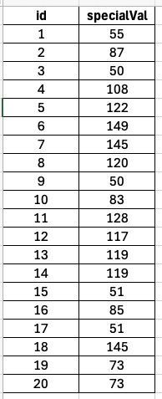
Back to Database Searching
Assume data is stored on disk by column id’s value
Searching for a specific id = fast.
But what if we want to search for a specific specialVal?
Only option is linear scan of that column
Can’t store data on disk sorted by both id and specialVal (at the same time)
data would have to be duplicated → space inefficient

Slide 11
Back to Database Searching
Assume data is stored on disk by column id’s value
Searching for a specific id = fast.
But what if we want to search for a specific specialVal?
Only option is linear scan of that column
Can’t store data on disk sorted by both id and specialVal (at the same time)
data would have to be duplicated → space inefficient
We need an external data structure to support faster searching by specialVal than a linear scan.

Slide 12
What do we have in our arsenal?
What we are really talking about database indexes.
An array of tuples (specialVal, rowNumber) sorted by specialVal
We could use Binary Search to quickly locate a particular specialVal and find its corresponding row in the table
But, every insert into the table would be like inserting into a sorted array - slow…
A linked list of tuples (specialVal, rowNumber) sorted by specialVal
searching for a specialVal would be slow - linear scan required
But inserting into the table would theoretically be quick to also add to the list.

Slide 13
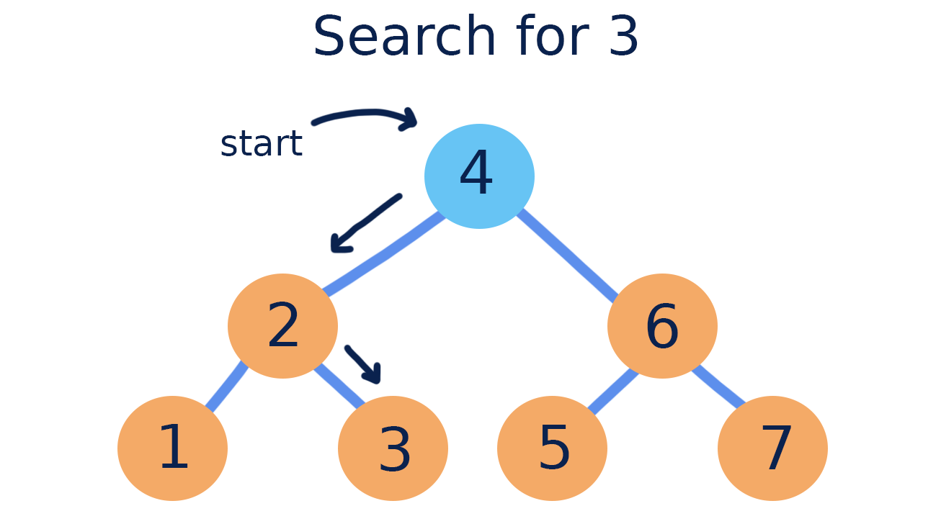
Something with Fast Insert and Fast Search?
Binary Search Tree - a binary tree where every node in the left subtree is less than its parent and every node in the right subtree is greater than its parent.
Image from: https://courses.grainger.illinois.edu/cs225/sp2019/notes/bst/

Slide 14
To the Board!

